Slide 1
bb
SENTIMENT ANALYSIS OF IMDb REVIEWS
https://www.pexels.com/photo/ocean-water-wave-photo-1295138/
aa

Slide 2
Project Members
Project Mentor
Dr. L. Shakkeera
Uday
Agarwal
Aryan
Tandon
Sahil
Gauba
Parv
Bhargava
19BAI10147
19BAI10148
19BAI10099
19BAI10116

Slide 3
bb
INTRODUCTION
Can you imagine manually sorting through thousands of tweets, customer support conversations, or surveys, or product reviews?
There’s just too much business data to process manually. Sentiment analysis helps businesses process huge amounts of data in an efficient and cost-effective way. In the previous review we’ve already discussed how sentiment analysis depends on polarity and even the feelings, emotions and intentions of reviewers. Sentiment analysis, also known as opinion mining, is essential as analyzing customer feedback such as opinions in survey responses, social media conversations and product reviews allows business and brands to listen attentively to their customers and tailor products and services to meet their needs.
https://www.pexels.com/photo/ocean-water-wave-photo-1295138/
aa

Slide 4
EXISTING WORK WITH
LIMITATIONS
02
Tech Analyzing
Donec ornare rutrum neque sit amet pellentesque. Nulla eget dictum tortor.
g

Slide 5
bb
Method | Proposal | Classification | Text Level | Prediction Accuracy | Pros | Cons
OPINE | 2005 | Unsupervised rule-based approach | Word | 87% | Domain independent | Difficulty in availing OPINE system, thus rare to get applied in real life
Sentiment Analysis: Adjectives and Adverbs are better than Adjectives alone | 2006 | Linguistic Approach | Document | Pearson correlation of 0.47 | Adjectives are given more priority (adjectives express human sentiments better than adverbs alone) | None
Opinion Digger | 2010 | Unsupervised Machine Learning Method | Sentence | 51% | Rates product at aspect level | Requires rating guidelines to rate. Works only on known data
Sentiment Classification using Lexical Contextual Sentence Structure | 2011 | Rule based Approach | Sentence | 86% | Said to be domain independent | Depends solely on WordNet
Independent Latent Dirichlet Allocation | 2011 | Probabilistic Graphical Model | Document | 73% | Faster in comparing and correlating sentiment and rating | Correlation between identified clusters and feature or ratings are not explicit always
A joint Model of Feature Mining and Sentiment Analysis for Product Review Rating | 2011 | Machine Learning | Document | 71% (in 3 categories); 46.9% (in 5 categories) | Automatic calculation of feature vector | Use of WordNet
Table 1
https://www.pexels.com/photo/ocean-water-wave-photo-1295138/
aa

Slide 6
PROPOSED WORK
The project presents the theoretical analysis of methods or proposal of Sentiment Analysis of the reviews of a particular movie on IMDb. Both the advantages and disadvantages of the discussed methods are considered to add new features in the proposed approach. The new approach follows machine learning technique at document level with combination of adjectives, adverbs, and verbs. The project is completed using PyCharm, Jupyter Notebook, Matplotlib, TextBlob, NLTK and Spacy. The project uses Natural Language Processing and Machine Learning to interpret and classify emotions of different reviewers in subjective data.
02
Tech Analyzing
Donec ornare rutrum neque sit amet pellentesque. Nulla eget dictum tortor.
g

Slide 7
METHODOLOGY
02
Tech Analyzing
Donec ornare rutrum neque sit amet pellentesque. Nulla eget dictum tortor.
g

Slide 8

1.
Importing the IMDb Movie Reviews’ Dataset
02
Tech Analyzing
Donec ornare rutrum neque sit amet pellentesque. Nulla eget dictum tortor.

Slide 9
01
Start Here
Donec ornare rutrum neque sit amet pellentesque. Nulla eget dictum tortor.
2.
Active Learning and Data Preprocessing
03
Creation Process
Donec ornare rutrum neque sit amet pellentesque. Nulla eget dictum tortor.

Slide 10
02
Tech Analyzing
Donec ornare rutrum neque sit amet pellentesque. Nulla eget dictum tortor.
g
3.
Tokenization and Stop Words Removal
04
Test Process
Donec ornare rutrum neque sit amet pellentesque. Nulla eget dictum tortor.

Slide 11
03
Creation Process
Donec ornare rutrum neque sit amet pellentesque. Nulla eget dictum tortor.
s
4.
Parts of Speech (POS) Tagging & Feature Extraction
05
Finish Process
Donec ornare rutrum neque sit amet pellentesque. Nulla eget dictum tortor.
D

Slide 12
04
Test Process
Donec ornare rutrum neque sit amet pellentesque. Nulla eget dictum tortor.
d
5.
Result Interpretation
g
Option Seven
Donec ornare rutrum neque sit amet pellentesque. Nulla eget dictum tortor.

Slide 13
bb
NOVELTY OF THE PROJECT
In this project, we will analyze the reviews of a movie. The reviews are unstructured. In other words, the text is unorganized. Sentiment analysis will help in making sense of all this unstructured text by automatically tagging it. We investigate the potential of using sentiment attitudes (positive vs negative) and also sentiment emotions (joy, sadness, etc.) extracted from these reviews. We will use the NTLK library which will help to remove unnecessary data from the dataset. The different emotions felt by the users related to the movie are displayed and the overall polarity of the unlabeled dataset is shown.
https://www.pexels.com/photo/ocean-water-wave-photo-1295138/
aa

Slide 14
bb
REAL TIME USAGE
https://www.pexels.com/photo/ocean-water-wave-photo-1295138/
aa

Slide 15
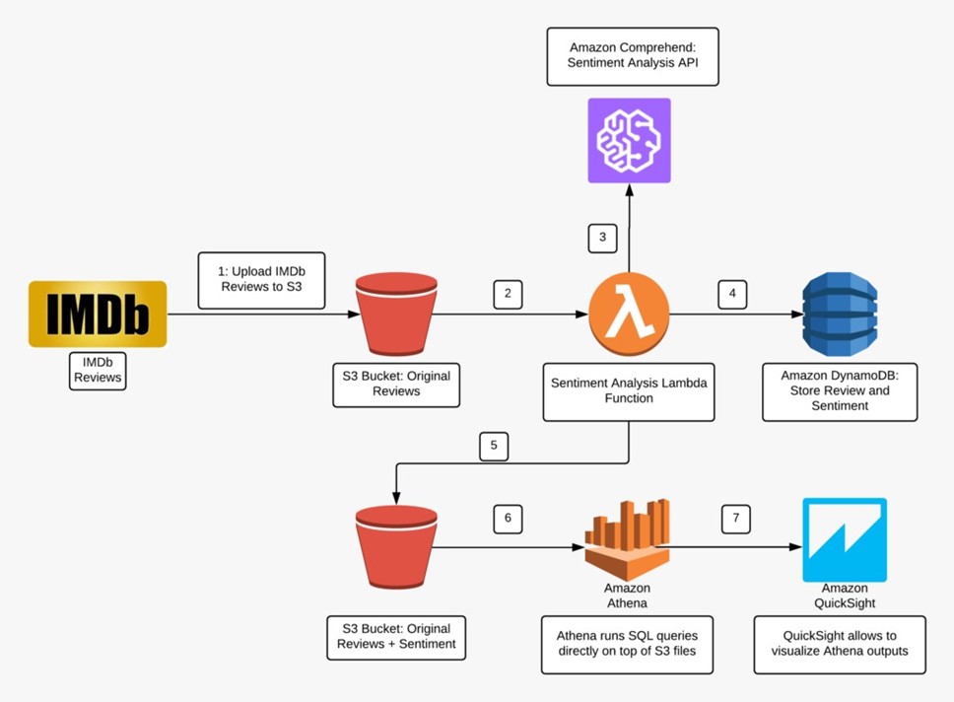
bb
Analyzing IMDb Reviews: IMDb is an entertainment review website where people leave their opinions on different movies and shows. You can perform sentiment analysis on the reviews present there as well. Reviews of shows and movies help production companies in understanding why their title failed (or succeeded).
Fig. 1
https://www.pexels.com/photo/ocean-water-wave-photo-1295138/
aa

Slide 16
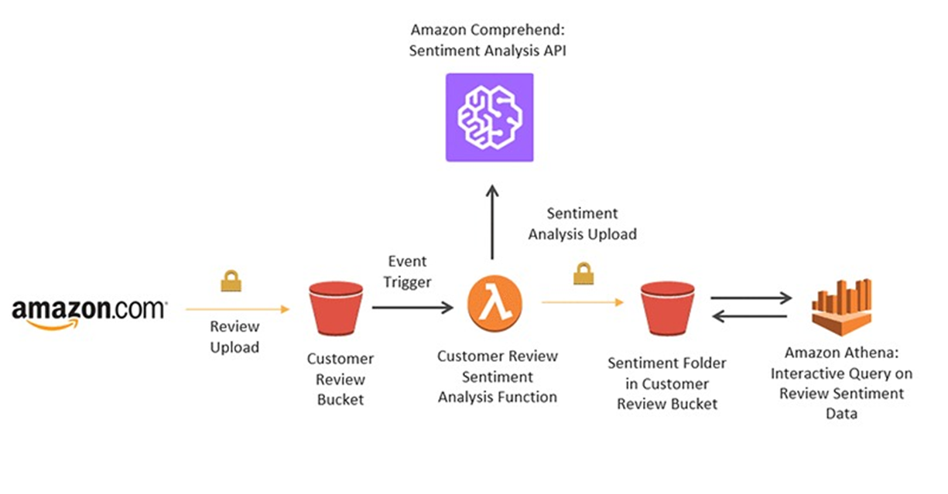
bb
Analyzing Amazon Product Reviews: Amazon is the biggest e-commerce store on the planet. This means it also has one of the largest product selections available. Many times, companies want to understand the public opinion on their product and figure out what’s responsible for the same. For that purpose, they perform sentiment analysis on their product reviews. It helps them in recognizing the primary issues with their products (if there are any). Some products have thousands of reviews on Amazon while some others only have a few hundred.
Fig. 2
https://www.pexels.com/photo/ocean-water-wave-photo-1295138/
aa

Slide 17
bb
HARDWARE REQUIREMENTS
RAM : 8GB Recommended
Processor : Intel Core i3 equivalent or better
Keyboard
Mouse
Monitor
https://www.pexels.com/photo/ocean-water-wave-photo-1295138/
aa

Slide 18
bb
SOFTWARE REQUIREMENTS
Windows 10
Any Python IDE like PyCharm
Sublime Text or VC as Text Editor
Python Flask for Building Web Service
https://www.pexels.com/photo/ocean-water-wave-photo-1295138/
aa

Slide 19
bb
OVERALL SYSTEM ARCHITECTURE
https://www.pexels.com/photo/ocean-water-wave-photo-1295138/
aa

Slide 20
Data Filtration
Positive and Negative File
Merge
Single Positive and Negative File
Filtration of Fillers
Final Positive and Negative
Training Model
Pre-Process
Feature Extraction
Machine Learning Algorithm
Classification Model
Prediction Label
Testing Model
Testing Input
Pre-Process
Feature Extraction
Classification Model
Prediction Label
Fig. 3

Slide 21
bb
OVERALL SYSTEM ARCHITECTURE
Data Filtration: Data Filtration importing all positive and negative datasets from file and combining them into a single file. The data sets may contain lots of unwanted symbols, and number. These factors need to be corrected or solved to increase the efficiency. Therefore, in this process the unwanted symbols and number are removed.
Training Model: Fetching the datasets from the file and extracting all the corresponding words (feature words) like adjective, adverb and verb. Then datasets are labelled a respectively as “pos” for positive and “neg” for negative. Then performing frequency distribution over collected words and selecting 5000 words for training. Again, the shuffling of data is performed using random seed for better training. Here, the labeled datasets are divided into the percentile of 70-30% for training and testing, respectively. Training dataset to classification algorithms like Naïve Bayes classification algorithm [5], Linear Model algorithm [16], SVM algorithm and Decision tree.
Testing Model: Here user can test and analysis the respective model by performing preprocessing over the input data. The preprocessing contains the removal of the symbol and number. Mapping to user input using saved featured (based on training dataset). Then feed to saved model for prediction.
https://www.pexels.com/photo/ocean-water-wave-photo-1295138/
aa

Slide 22
bb
LITERATURE REVIEW – SENTIMENT
ANALYSIS ON IMDb DATASET
https://www.pexels.com/photo/ocean-water-wave-photo-1295138/
aa

Slide 23
bb
REFERENCES
(Literature Review Continued)
Xing Fang & Justin Zhan – Sentiment analysis using product review data – Journal of Big Data volume 2, Article number: 5 (2015)
Faisal Muhammad Shah, Nudrat NAWAL Saber, Tanjim Ul Haque – Sentiment Analysis on Large Scale IMDb Product Reviews ‖ ICIRD At: Bangkok, Thailand (June 2018 DOI)
Aashutosh Bhatt, Ankit Patel, Harsh Chheda, Kiran Gawande – IMDb Review Classification and Sentiment Analysis || IJCSIT Vol. 6 (6) , 2015, 5107-5110
https://www.pexels.com/photo/ocean-water-wave-photo-1295138/
aa

Slide 24
bb
(LITERATURE REVIEW CONT.)
[1] Sentiment analysis using product review data
NEED OF THE PROBLEM: Fang and Zhan have addressed the problem of polarity categorization that determines whether a review is positive, negative or neutral. A general process for sentiment polarity categorization is discussed with detailed process descriptions. They have also mentioned the flaws related to collection of online data by developers that hinders the process of sentiment analysis. The first flaw is that since people can freely post their own content, the quality of their opinions cannot be guaranteed. The second flaw is that ground truth of such online data is not always available. A ground truth is more like a tag of a certain opinion, indicating whether the opinion is positive, negative, or neutral.
PROPOSED SOLUTION BY THEM: The above mentioned flaws have been overcome in the following two ways: First, each movie review receives inspections before it can be posted. Second, each review must have a rating on it that can be used as the ground truth. The rating is based on a star-scaled system, where the highest rating has 10 stars and the lowest rating has only 1 star. The authors proposed a three phase model to solve the problem of polarity categorization, where the major work lies in the second and third phases.
- In Phase Two the following steps are performed:
An algorithm is proposed and implemented for negation phrases identification;
A mathematical approach is proposed for sentiment score computation;
A feature vector generation method is presented for sentiment polarity categorization.
https://www.pexels.com/photo/ocean-water-wave-photo-1295138/
aa

Slide 25
bb
(LITERATURE REVIEW CONT.)
- In Phase Three:
Two sentiment polarity categorization experiments are respectively performed based on sentence level and review level;
Performance of three classification models are evaluated and compared based on their experimental results. Software used in this study is sci-kit learn which is an open source machine learning package in Python. The classification models selected for categorization are : Random Forest, Support Vector Machine and Naive Bayesian.
KEY FINDINGS: It is observed that both the SVM model and the Naive Bayesian model are identical in terms of their performances. Both models are generally superior than the Random Forest model on all vector sets. Even though there are reports of spams on imdb.com, it is still a relatively spam-free website in terms of reviews because of the enforcement of its review inspection process. Another important observation we made is that for sentiment analysis, a POS tagger is very useful because of the following two reasons:
Words like nouns and pronouns usually do not contain any sentiment. A POS tagger will be able to filter out such words;
A POS tagger can also be used to distinguish words that can be used in different parts of speech.
https://www.pexels.com/photo/ocean-water-wave-photo-1295138/
aa

Slide 26
bb
(LITERATURE REVIEW CONT.)
[2] Sentiment Analysis on Large Scale Amazon Product Reviews
NEED OF THE MODEL: As the commercial site of the world is almost fully undergone in online platform people is trading products through different e-commerce website. And for that reason reviewing products and movies before spending money on these services is also a common scenario. Also nowadays, customers are more inclined towards the reviews to buy a product. So analyzing the data from those customer reviews to make the data more dynamic is an essential field nowadays.
PROPOSED SOLUTION BY THEM: Shah et al used both manual and active learning approach to label the datasets. In the active learning process different classifiers are used to provide accuracy until reaching satisfactory level. After getting satisfactory result the labeled datasets were taken and processed. From the processed dataset we extracted features that are then classified by different classifiers. Combination of two kinds of approaches to extract features were used.
KEY FINDINGS: A supervised learning model is proposed to polarize a large amount of product review dataset which was unlabeled. The proposed model is a supervised learning method and uses a mix of 2 kinds of feature extractor approach for higher accuracy.
https://www.pexels.com/photo/ocean-water-wave-photo-1295138/
aa

Slide 27
bb
(LITERATURE REVIEW CONT.)
[3] Amazon Review Classification and Sentiment Analysis
NEED OF THE MODEL: Reviews on Amazon are not only related to the product but also the service given to the customers. If users get clear bifurcation about product reviews and service reviews it will be easier for them to take the decision.
PROPOSED SOLUTION BY THEM: Bhatt et al ensured fair results of sentiment thereby saving the users’ time to read through long textual description in the reviews. This was done with the help of the following steps, namely: (i) Data Scraping; (ii) Data Cleaning; (iii) Classifying the reviews into service review and product review; (iv) Extracting features and Parts of Speech (POS) tagging, and (v) Interpreting the Result.
KEY FINDINGS:
1. Classification of Reviews along with sentiment analysis increased the accuracy of the system which in turn provided accurate reviews to the user.
2. Data visualization is an important technology in the upcoming future.
3. Facts are objective statements about entities and worldly events and opinions are subjective statements that reflect people’s sentiments.
4. Maximum amount of existing research on text and information processing is focused on mining and getting the factual information from the text or information.
https://www.pexels.com/photo/ocean-water-wave-photo-1295138/
aa

Slide 28
bb
MODULE DESCRIPTION
https://www.pexels.com/photo/ocean-water-wave-photo-1295138/
aa

Slide 29
bb
STEP 1: DATA ACQUISITION
As we have a large amount or reviews manually labeling was quite impossible for us. Therefore we preprocessed our data and used Active learner to label the datasets. As IMDb reviews comes in a 10-star rating system, generally 6 star ratings are considered as neutral reviews meaning neither positive nor negative. So we discard any review which contains a 6-star rating from our dataset and take the other reviews and proceed to next step labeling the dataset.
https://www.pexels.com/photo/ocean-water-wave-photo-1295138/
aa

Slide 30
bb
STEP 2: ACTIVE LEARNING
Active learning is a special case in semi-supervised learning algorithm. The main fact is that the performance will be better with less training if the learning algorithm is allowed to choose the data from which it learns. Active learning system tries to solve data labeling bottleneck by querying for unlabeled instance to be properly labeled by an expert. As manually labeling the dataset is quite an impossible task so that to reduce time complexity we use a special kind of semi-supervised learning approach known as active learning. In the process of our active learning we need to provide it some pre labeled datasets as training and testing and take unlabeled dataset. For using active learning, we need to provide some manually labeled reviews as training–testing sets. And it will run some classifiers and will tell us the output.
https://www.pexels.com/photo/ocean-water-wave-photo-1295138/
aa

Slide 31
bb
STEP 3: TOKENIZATION
Tokenization is the process of separating a sequence of strings into individuals such as words, keywords, phrases, symbols and other elements known as tokens. Tokens can be individual words, phrases or even whole sentences. In the process of tokenization, some characters like punctuation marks are discarded. The tokens work as the input for different process like parsing and text mining.
In other words, it is the process of converting text into tokens before transforming it into vectors. It is also easier to filter out unnecessary tokens. For example, a document into paragraphs or sentences into words. In this case we are tokenizing the reviews into words.
Tokenization can be done to either separate words or sentences. If the text is split into words using some separation technique it is called word tokenization and same separation done for sentences is called sentence tokenization.
https://www.pexels.com/photo/ocean-water-wave-photo-1295138/
aa

Slide 32
bb
STEP 4: REMOVING STOP WORDS
Stop words are those objects in a sentence which are not necessary in any sector in text mining. So we generally ignore these words to enhance the accuracy of the analysis.
Stop words are the most commonly occurring words which are not relevant in the context of the data and do not contribute any deeper meaning to the phrase. In this case contain no sentiment. NLTK provide a library used for this.
https://www.pexels.com/photo/ocean-water-wave-photo-1295138/
aa

Slide 33
bb
STEP 5: PARTS OF SPEECH TAGGING
The process of assigning one of the parts of speech to the given word is called Parts of Speech tagging. It is generally referred to as POS tagging. Parts of speech generally contain nouns, verbs, adverbs, adjectives, pronouns, conjunction and their sub-categories. Parts of Speech tagger or POS tagger is a program that does this job.
In other words, it is the process of classifying words into their parts of speech and labeling them accordingly. It processes a sequence of words, and attaches a part of speech tag to each word. When a user reviews a movie, the best clue to his/her opinions is given by the adjectives used in the reviews. Thus, it can be said that POS Tagger classifies whether a word is an adjective or a noun.
https://www.pexels.com/photo/ocean-water-wave-photo-1295138/
aa

Slide 34
bb
STEP 6: FEATURE EXTRACTION
Feature extraction involves reducing the number of resources required to describe a large set of data. It is a general term for methods of constructing combinations of the variables to get around these problems while still describing the data with sufficient accuracy. It identifies those product aspects which are being commented by customers, sentiment prediction identifies the text containing sentiment or opinion by deciding sentiment polarity as positive, negative or neutral.
Finally the results obtained from previous steps are aggregated and displayed, which is known as result interpretation.
https://www.pexels.com/photo/ocean-water-wave-photo-1295138/
aa

Slide 35
bb
MODULE WORKFLOW EXPLANATION
https://www.pexels.com/photo/ocean-water-wave-photo-1295138/
aa

Slide 36
Import The Dataset
Training Data
Active Learning
Testing Data
Preprocessing
Tokenization
Stopwords Removal
POS Tagging
Classification Model
Feature Extraction
Supervised Learning
Result Interpretation
Fig. 4

Slide 37
Import The Dataset
Training Data
Active Learning
Testing Data
Preprocessing
Tokenization
Stopwords Removal
POS Tagging
Classification Model
Feature Extraction
Supervised Learning
Result Interpretation
Fig. 4

Slide 38
bb
(MODULE WORKFLOW EXPLANATION CONT.)
Import the Dataset : Initially we import the Movie Reviews’ Dataset to our model.
Active learning: In this step, we provide some pre-labelled dataset as training and testing and take unlabeled dataset.
Data Preprocessing: The data extracted need to be cleaned so that we get proper text review on which analysis can be performed.
Tokenization: Here we separate the sequence of strings into individuals such as words, keywords, phrases, symbols and other elements known as tokens.
Stop Words removal : Here we remove all the unnecessary words from a sentence.
Parts of Speech (POS) tagging: The process of assigning one of the parts of speech to the given word is called Parts of Speech tagging. POS tagger is very useful because of the following two reasons: (a) words like nouns and pronouns usually do not contain any sentiment. It is able to filter out such words with the help of a POS tagger, and; (b) a POS tagger can also be used to distinguish words that can be used in different parts of speech. For instance, as a verb, “enhanced” may conduct different amount of sentiment as being of an adjective.
Feature Extraction: In this step the model extracts all the important features which are useful in evaluating the result and ignores the rest as those features might affect the accuracy level of the model.
Supervised Learning: Here the sentiments are classified.
Result Interpretation : Final label - positive or negative workflow explanation.
https://www.pexels.com/photo/ocean-water-wave-photo-1295138/
aa

Slide 39
bb
IMPLEMENTATION AND CODING
https://www.pexels.com/photo/ocean-water-wave-photo-1295138/
aa

Slide 40
bb
IMPLEMENTATION
NLTK (Natural Language Toolkit)
In our project for performing sentiment analysis, we have used the NLTK package of Python which is a suite of libraries and programs for statistical NLP. It is used in the tokenize the text and has been used as a POS (Part of Speech) tagger. POS tagging is the process of marking up a word in a text as corresponding to a particular part of speech based on its definition and its context.
TextBlob
It is a module which is used for building programs for text analysis. One of the most important aspects of the TextBlob module is the POS tagging. Its goal is to assign linguistic information to substantial units.
Scikit Learn
Scikit-learn is a free software machine learning library for the Python programming language. It features various classification, regression and clustering algorithms including support vector machines, random forests, gradient boosting, k-means and DBSCAN, and is designed to interoperate with the Python numerical and scientific libraries NumPy and SciPy.
https://www.pexels.com/photo/ocean-water-wave-photo-1295138/
aa

Slide 41
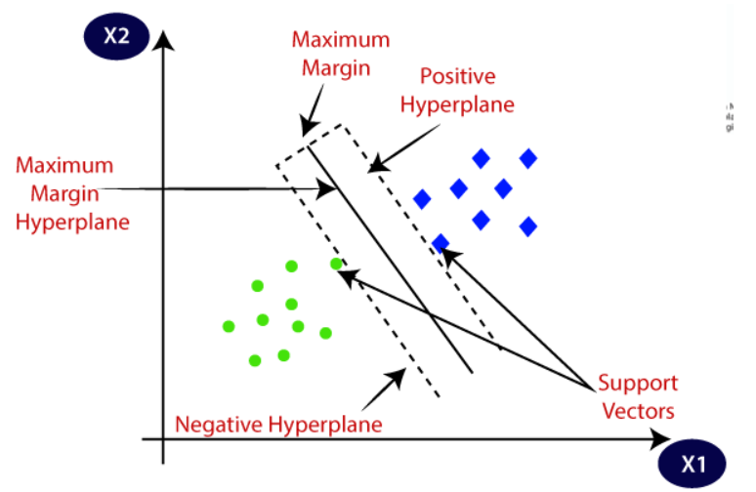
SVM
Support Vector Machine” (SVM) is a supervised machine learning algorithm which can be used for both classification or regression challenges. However, it is mostly used in classification problems. In the SVM algorithm, we plot each data item as a point in n-dimensional space (where n is number of features you have) with the value of each feature being the value of a particular coordinate. Then, we perform classification by finding the hyper-plane that differentiates the two classes very well.
Fig. 5

Slide 42
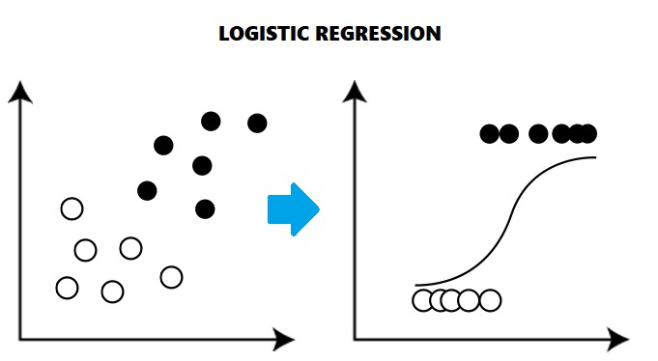
Logistic Regression
Logistic regression is a statistical model that in its basic form uses a logistic function to model a binary dependent variable, although many more complex extensions exist. In regression analysis, logistic regression (or logit regression) is estimating the parameters of a logistic model (a form of binary regression). Logistic regression is used to describe data and to explain the relationship between one dependent binary variable and one or more nominal, ordinal, interval or ratio-level independent variables.
Fig. 6

Slide 43
bb
CODING
Stop Words: They are the English words which does not add much meaning to a sentence. They can safely be ignored without sacrificing the meaning of the sentence. For example, the words like the, he, have etc. Such words are already captured this in corpus named corpus.
#Removing Stop Words final_words = [] for word in tokenized_words: if word not in stopwords.words(‘English’): final_words.append(word)
Tokenization: In Python tokenization basically refers to splitting up a larger body of text into smaller lines, words or even creating words for a non-English language.
#Using word_tokenize because it’s faster than split() tokenized_words = word_tokenize(cleaned_text, “english”)
https://www.pexels.com/photo/ocean-water-wave-photo-1295138/
aa

Slide 44
bb
DEMO VIDEO
https://www.pexels.com/photo/ocean-water-wave-photo-1295138/
aa

Slide 45
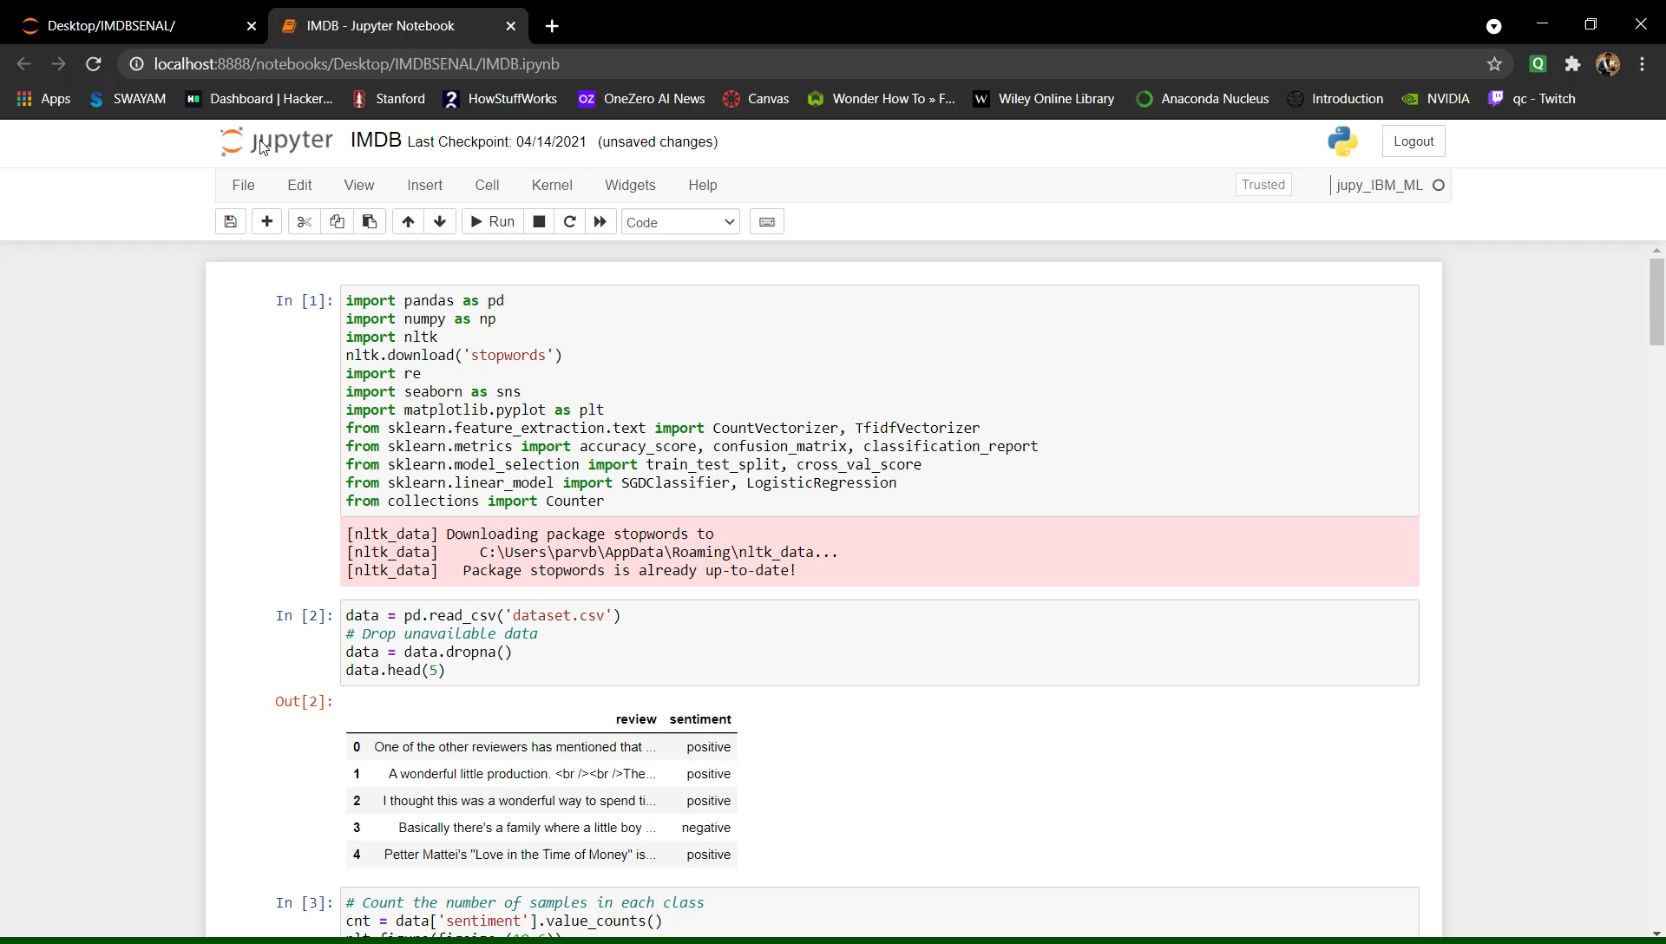
bb
https://www.pexels.com/photo/ocean-water-wave-photo-1295138/
aa

Slide 46
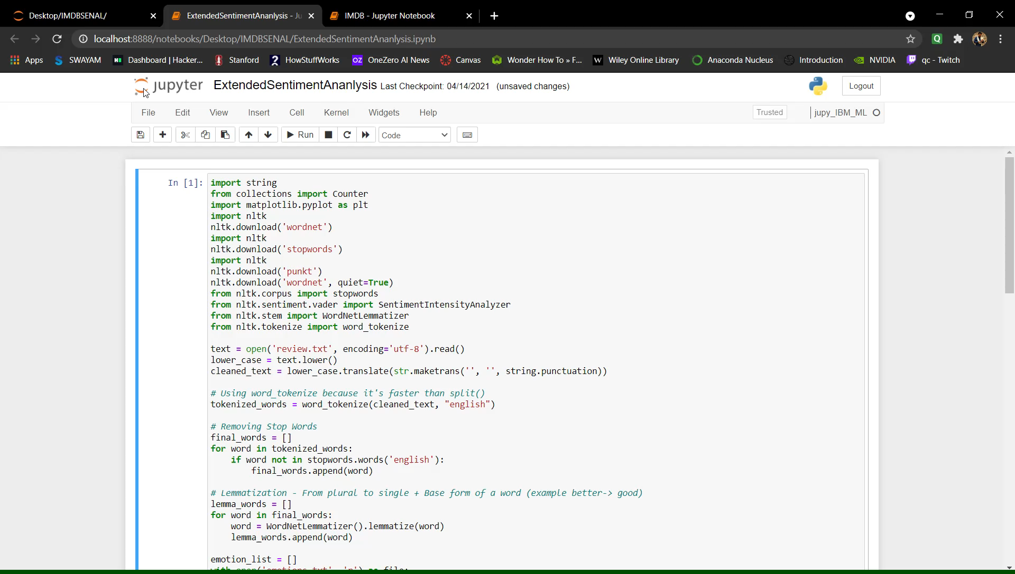
bb
https://www.pexels.com/photo/ocean-water-wave-photo-1295138/
aa

Slide 47
bb
SNAP SHOT OF THE PROJECT
https://www.pexels.com/photo/ocean-water-wave-photo-1295138/
aa

Slide 48
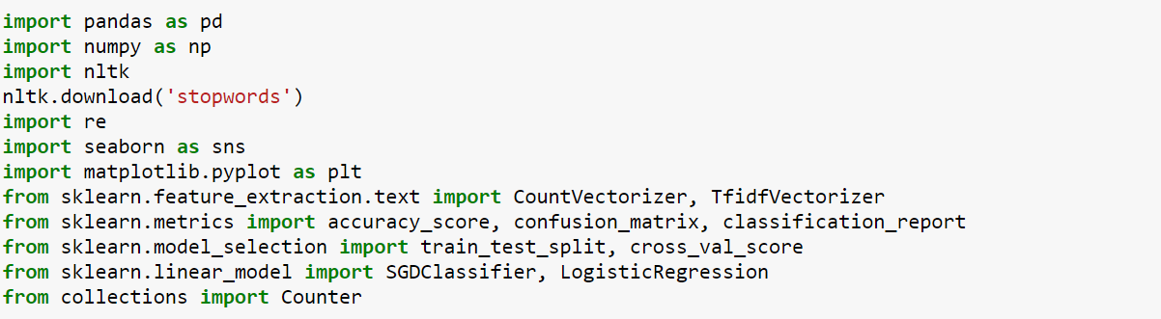
bb
Fig. 7
https://www.pexels.com/photo/ocean-water-wave-photo-1295138/
aa

Slide 49
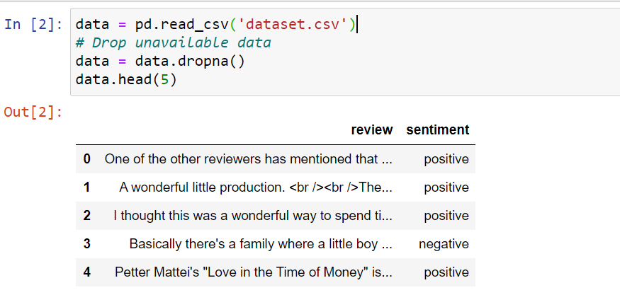
bb
Fig. 8
https://www.pexels.com/photo/ocean-water-wave-photo-1295138/
aa

Slide 50
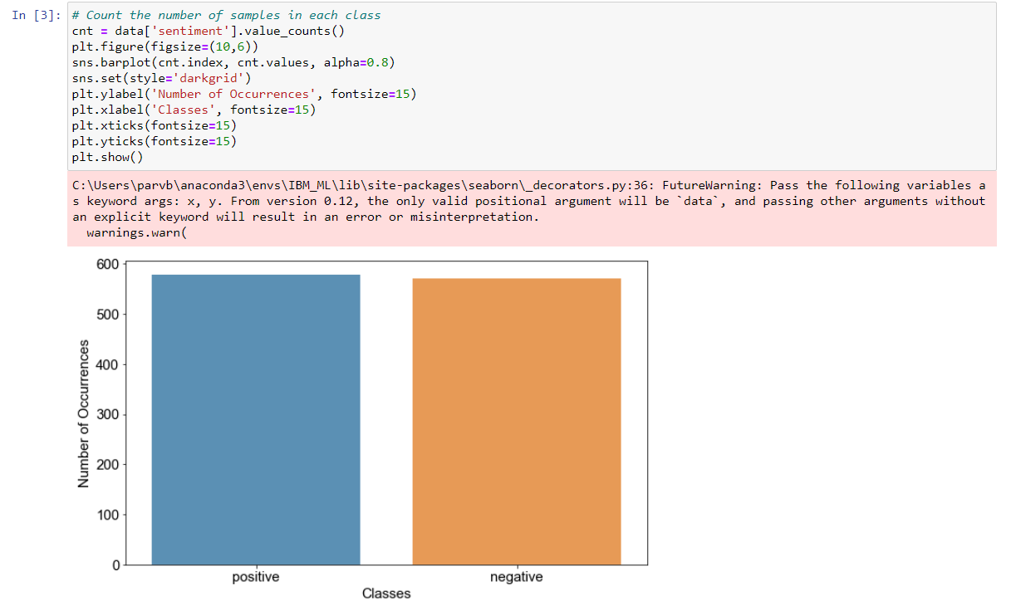
bb
Fig. 9
https://www.pexels.com/photo/ocean-water-wave-photo-1295138/
aa

Slide 51
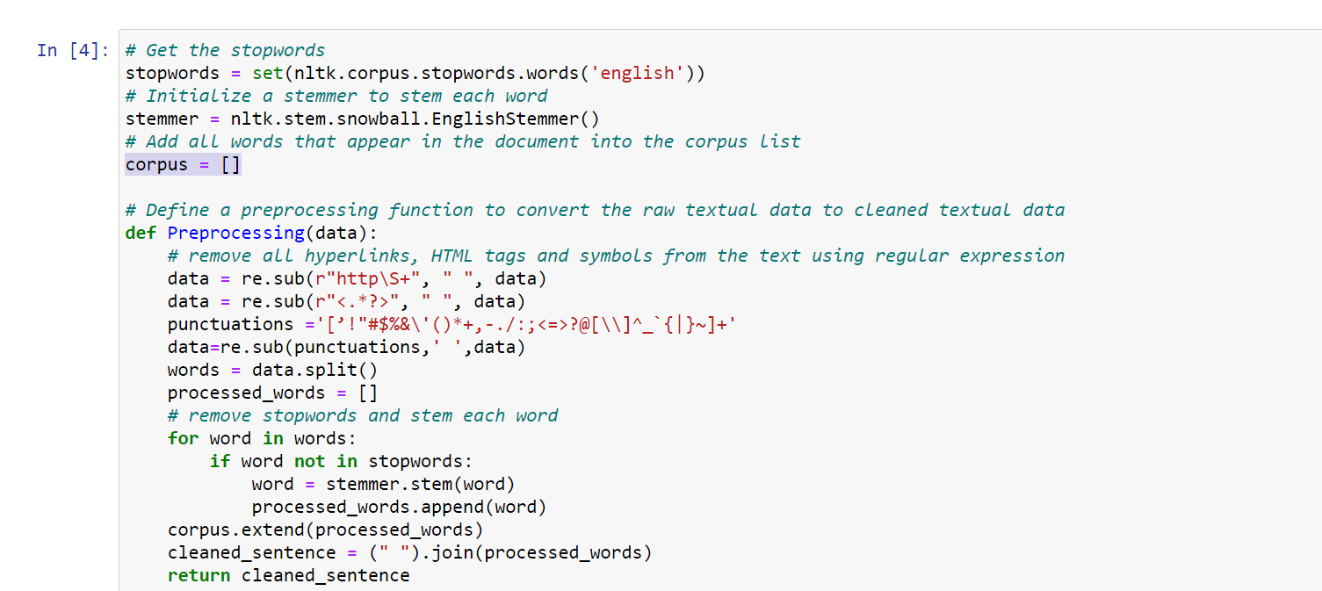
bb
Fig. 10
https://www.pexels.com/photo/ocean-water-wave-photo-1295138/
aa

Slide 52
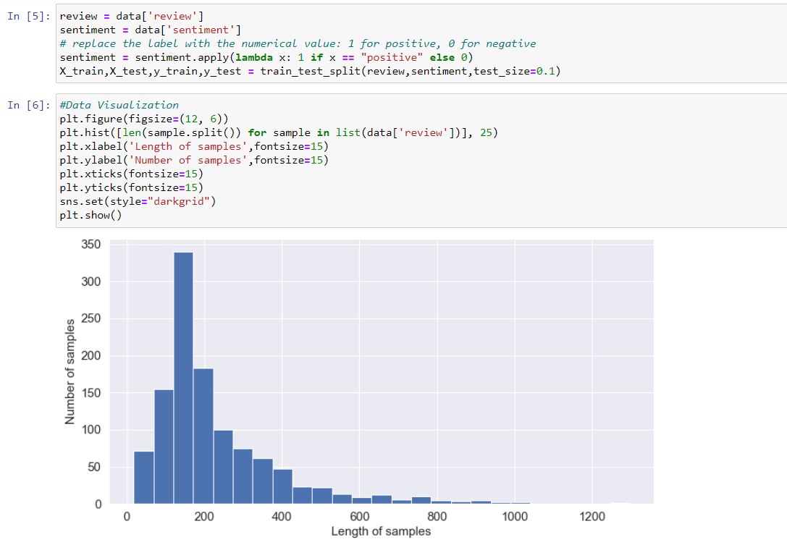
bb
Fig. 11
https://www.pexels.com/photo/ocean-water-wave-photo-1295138/
aa

Slide 53
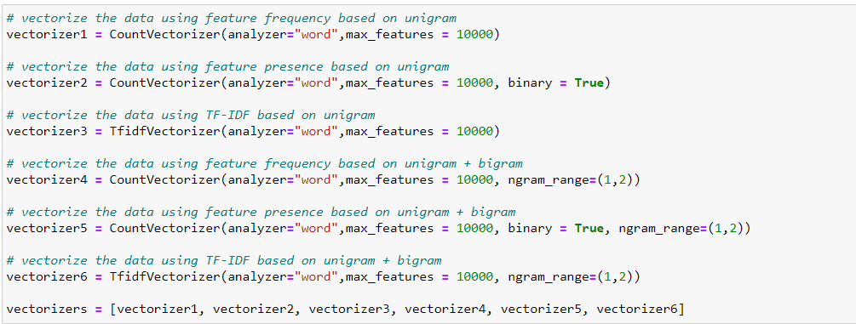
bb
Fig. 12
https://www.pexels.com/photo/ocean-water-wave-photo-1295138/
aa

Slide 54
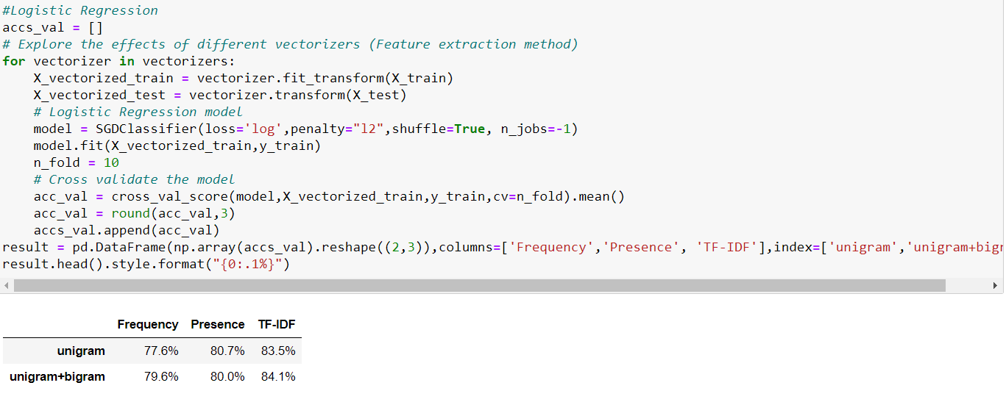
bb
Fig. 13
https://www.pexels.com/photo/ocean-water-wave-photo-1295138/
aa

Slide 55
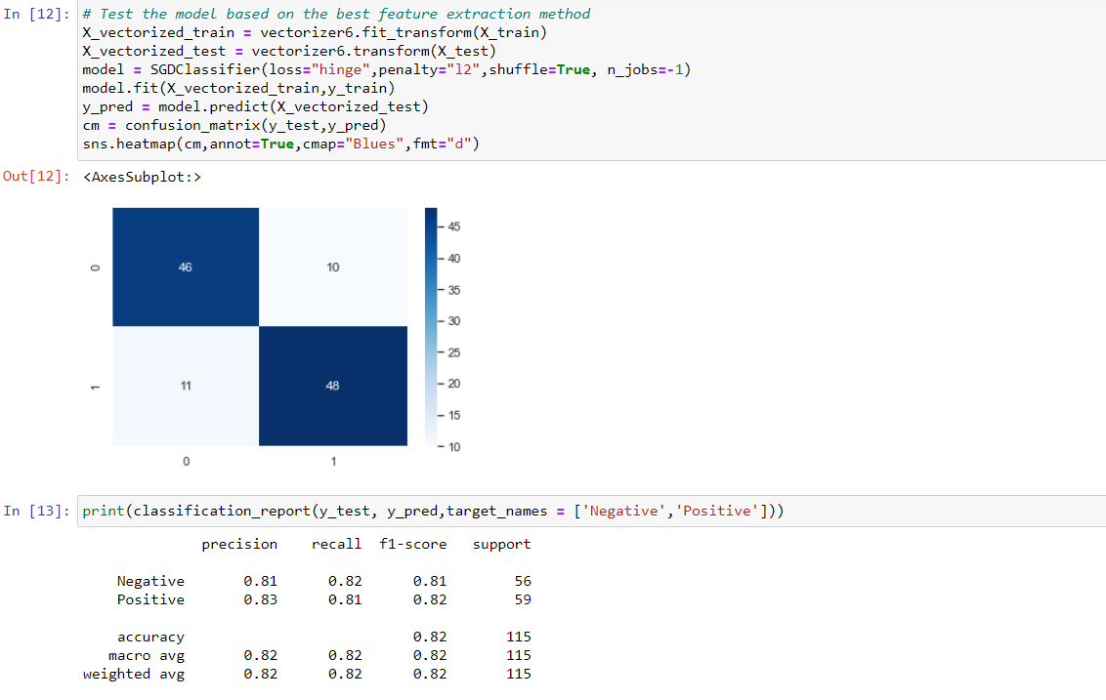
bb
Fig. 14
https://www.pexels.com/photo/ocean-water-wave-photo-1295138/
aa

Slide 56
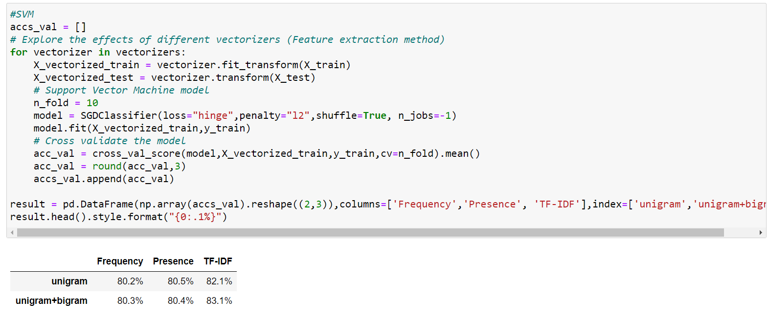
bb
Fig. 15
https://www.pexels.com/photo/ocean-water-wave-photo-1295138/
aa

Slide 57
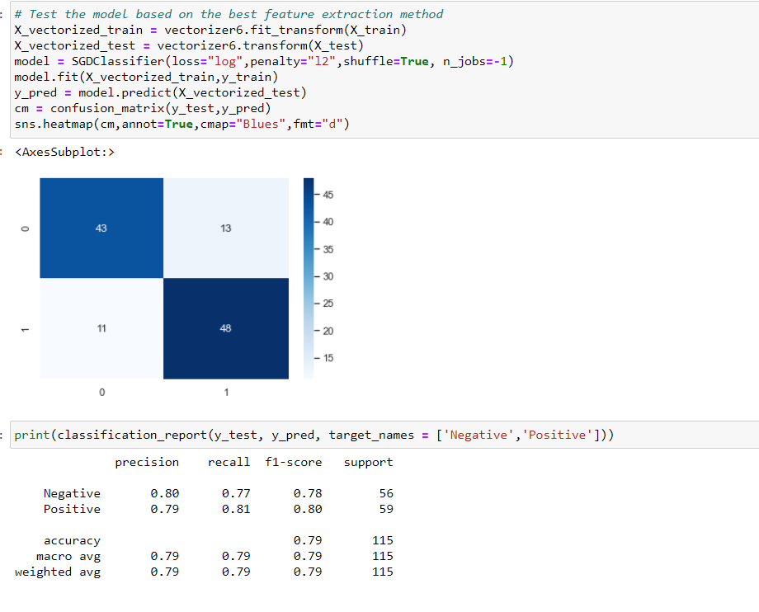
bb
Fig. 16
https://www.pexels.com/photo/ocean-water-wave-photo-1295138/
aa

Slide 58
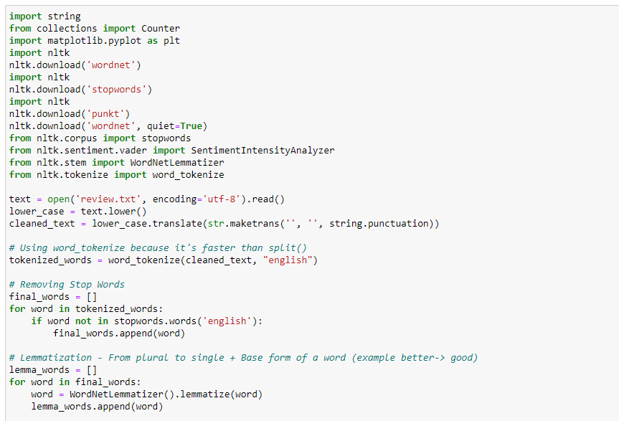
bb
Fig. 17
https://www.pexels.com/photo/ocean-water-wave-photo-1295138/
aa

Slide 59
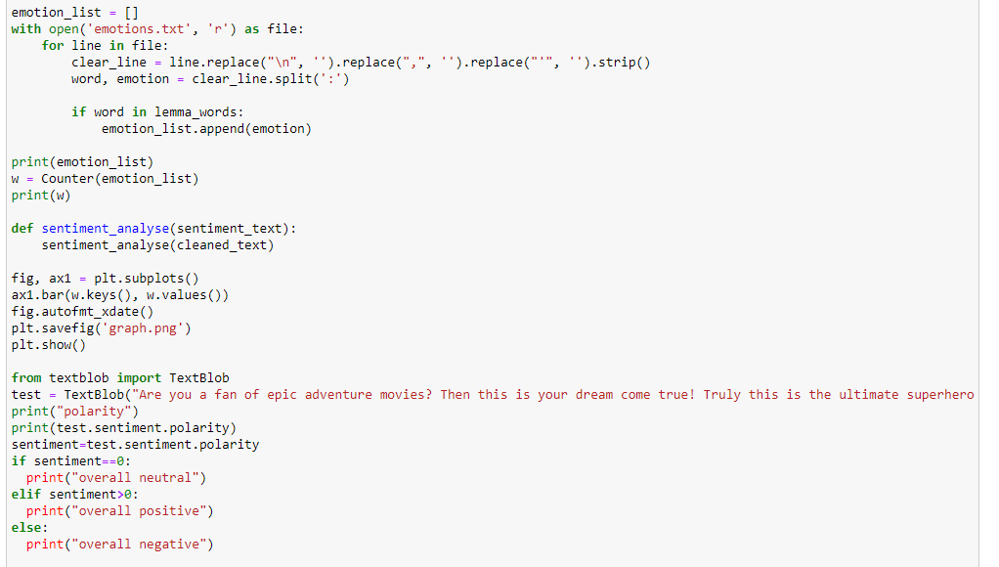
bb
Fig. 18
https://www.pexels.com/photo/ocean-water-wave-photo-1295138/
aa

Slide 60
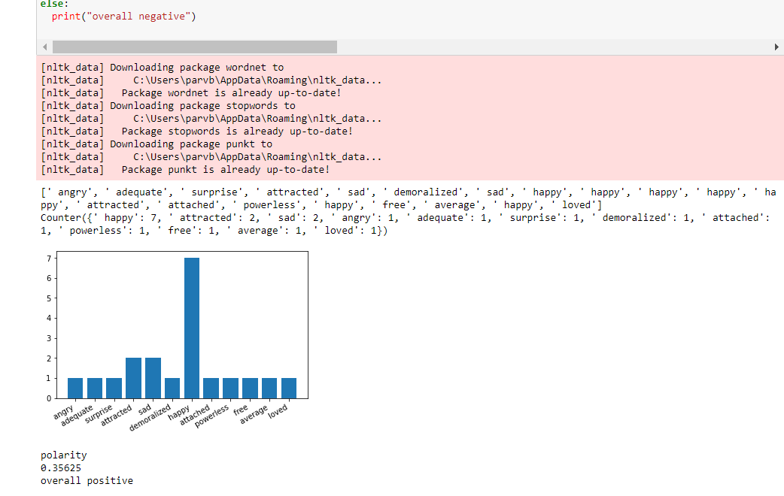
bb
Fig. 19
https://www.pexels.com/photo/ocean-water-wave-photo-1295138/
aa

Slide 61
TESTING
02
Tech Analyzing
Donec ornare rutrum neque sit amet pellentesque. Nulla eget dictum tortor.
g

Slide 62
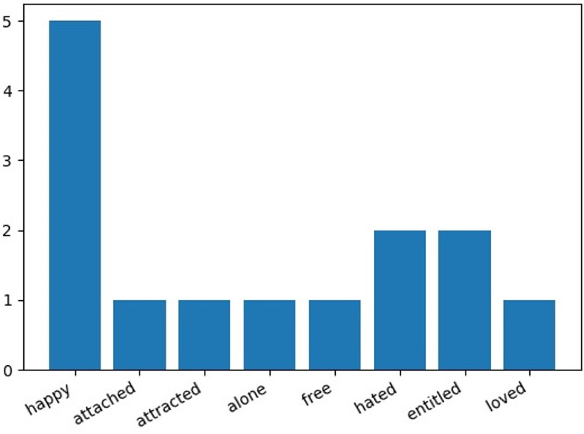
BEFORE
Output taking into consideration a small set of reviews.
Fig. 20
02
Tech Analyzing
Donec ornare rutrum neque sit amet pellentesque. Nulla eget dictum tortor.
g

Slide 63
AFTER
Output after taking the final dataset into consideration.
Fig. 21
02
Tech Analyzing
Donec ornare rutrum neque sit amet pellentesque. Nulla eget dictum tortor.
g

Slide 64
CONCLUSION
For sentiment analysis a methodology has been designed which integrates existing sentiment analysis approaches. The system is accurate enough for the test case of Avengers reviews on IMDb. Classification of reviews along with sentimental analysis increased the accuracy of the system which in turn provides accurate reviews to the user. This work could be extended to make the system of numbered star rating more useful to users.
02
Tech Analyzing
Donec ornare rutrum neque sit amet pellentesque. Nulla eget dictum tortor.
g

Slide 65
bb
THANK YOU
https://www.pexels.com/photo/ocean-water-wave-photo-1295138/
aa

